Slide 1


Comparison of Four Individual Software Engineering Projects
Hong Van, Ip Chan, Shubhashree Bhattacharya, Anil
CS 504: Software Engineering
Instructor: Shane Frigon
September 07, 2021
School of Technology & Computing (STC)

Slide 2
AGENDA
Introduction
IP01: Configuration Management Environment
IP02: Requirement and Architecture
IP03: Test Plan and Cases
IP04: Software Metric
Conclusion
Key Reference
Q&A

Slide 3

INTRODUCTION
Software engineering is about the development and maintenance of all the software that people use every day, from productivity tools to any web browsers.
Its main goals are creation, improvement, and maintenance of the software.
Project planning, system designing, implementation, testing of software, and maintenance are some of the important steps during the software development process.
Notes:
Software engineering is about the development and maintenance of all the software that people use every day, from productivity tools to any web browser. It is also about the application of engineering concepts to software development with the main goals of creation, improvement, and maintenance of software. There are many types of software that a software engineer can develop, such as operating systems, computer games, middleware, business applications, and network control systems.
When designing any software product, it is very important to analyze and understand clearly the needs of the customer, so any software engineer can design, test, and develop their software products to meet those needs. Moreover, during the software development process, project planning, system designing, implementation, testing of software, and maintenance are important steps that need to pay much attention to.
The purpose of this paper is to compare the differences and similarities of the four individual projects with the following topics: collaborative online judge system, IoT-based weather application, a web service to manage user’s password, and a vaccine scheduling system. Individual project one was about the introduction to the configuration management system (CMS). Individual project two focused on the project requirements engineering process and map the resulting requirements into a systems architecture or high-level design. Individual project three created a test plan including test cases for the system they designed for all four projects. Finally, individual four was about software metrics.

Slide 4
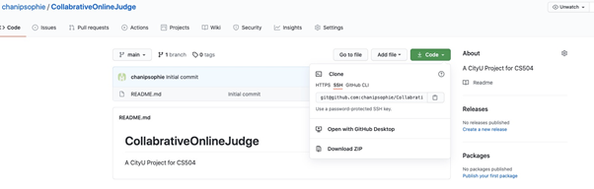
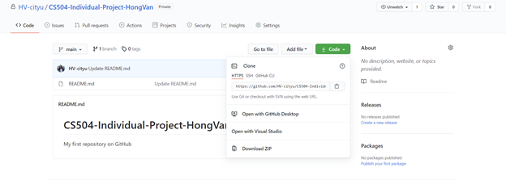
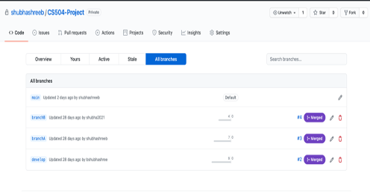
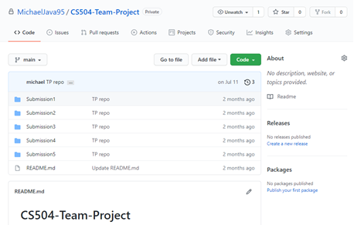
IP01: Configuration Management System
Git and GitHub were used as a CMS environment to perform this project. Tasks performance include:
Code check out
Code check in
Code snapshot
Code development
Code changes
Figure 1.1: GitHub Repository - Author# 1
Figure 1.2: GitHub Repository - Author# 2
Figure 1.3: GitHub Repository - Author# 3
Figure 1.3: GitHub Repository - Author# 4
Notes:
The first individual project was about the introduction to the configuration management system (CMS) and demonstrated how the related processes are handled in the CMS environment. CMS is a system engineering process that tracks and monitors changes to a software system configuration metadata. It uses version control software, such as Git, SVN, Hg (Mercurial), and ClearCase, to manage the state of software code as well as to track changes to the software over time. As the most popular version control system or online service, Git and GitHub were used as a CMS environment to perform this project. In this project, the authors were required to create a test case and perform the following situations in the GitHub environment including code check out, code check in, code snapshot, code development, and code changes. Below are the screenshots of each author’s GitHub repository in order to complete this first project.

Slide 5
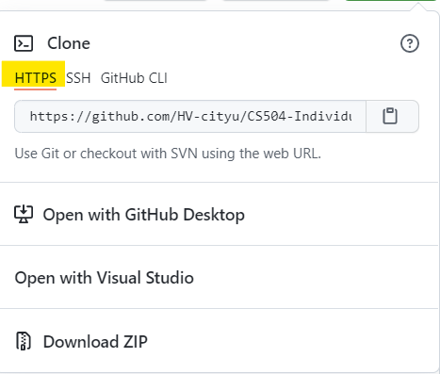
IP01: Configuration Management System
Comparison:
Check out code: The authors #2, #3, and #4 did git clone using HTTPS URL while the author #1 was using SSH URL. The author #4 also created a branch name and did a git clone using the “git clone –b branchName” command.
Code changes: each author made some changes to the code locally and saved it in the file that they just cloned into their local machine.
Code check in: all the authors used the following commands git add . , git commit -m “message”, and git push origin master to push their new code changes to GitHub.
Notes:
Since the authors were allowed to create different test cases to demonstrate each situation, each individual project had different code design and the output of each situation was different from each other as well. For the check out of the source code, all of the authors were able to clone the repo to their local machines successfully by running the “git clone” command. To do this, authors #2, #3, and #4 did git clone using HTTPS URL while author #1 was using SSH URL - see figure 1.1, 1.2, 1.3, and 1.4. Moreover, author #4 also created a branch name and did a git clone using the “git clone –b branchName” command. For the code changes, each author made some changes to the code locally and saved it in the file that they just cloned into their local machine. For source code check in, all the authors were also successfully pushing the new code changes to the CMS environment by using the following commands git add . , git commit -m “message”, and git push origin master. Commit means saving the state of the current codebase, and push is to send the changes committed to the GitHub environment so that other developers can see the changes.

Slide 6
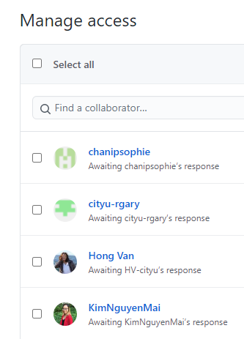
IP01: Configuration Management System
Comparison:
Code snapshot, one of the authors created a scenario to verify a user be able to create release from a given branch as well as to be able to update and edit release while another one included a commit message in the code and called it code snapshots.
Code development: the author #1 has demonstrated the situation by creating a new branch, called “bug_fixing”. The author #4, have shown the multiple users to prove that multiple users can work on a single project and this is generally done through branches. All the authors had proved the process successfully.
Notes:
For code snapshot, only three authors have done this part, one created a scenario to verify a user be able to create a release from a given branch as well as to be able to update and edit release while another one included a commit message in the code and called it code snapshots. In the last part, code development by 2 users, one is working on a new version, and one is fixing bugs in a previous release, author #1 has demonstrated the situation by creating a new branch, called “bug_fixing”. The purpose is to demonstrate that multiple developers can work together on different tasks without conflicting with the current release branch version. Author #4, has shown the multiple users - see the screenshot below - to prove that multiple users can work on a single project and this is generally done through branches. All the authors had proved the process successfully.

Slide 7
IP02: Requirement and Architecture
Main Requirement features:
The collaborative online judge systems:
Functional Requirement :
CRUD the problems
Submit code, execute code and show results
Non-functional Requirement:
User estimations
Security
Availability
Performance
Notes:
For individual project two, We will compare and analyze the requirements and high-level designs in this part
The collaborative online judge is a full-stack web app which supporting collaborative online code editing, compiling, execution, and result judgment.
The first functional requirements feature for this collaborative online judge systems. is CRUD problems that allow an admin to create, read, update, and delete (CRUD) code. Another core feature is Submit code, execute code, and show results.
and there are three major non-functional requirements for this system: security, availability, and performance.

Slide 8
IP02: Requirement and Architecture
Main Requirement features:
The vaccine scheduler system:
Functional requirement: Filtering vaccines by distance, date and age.
Non-functional requirements: The vaccine scheduler system needs to be accessible via the internet.
A web application is going to give the system multi-platform accessibility. The same web applications can be accessed from different operating systems and from different types of devices such as phones, tablets, laptops, and desktops.
Notes:
vaccine scheduler system is to allow people to reserve a time slot remotely, in order to decrease unvaccinated contact.
The functional requirements of the this system are showing the closest vaccination spots, and the available date and time slots.
The non-functional requirements are to be secure and accessible via the internet.

Slide 9
IP02: Requirement and Architecture
Main Requirement features:
The password management web service:
Allow a user to create/add, store, update, and delete their accounts and passwords into the system database.
Users need to list all the names of the applications, usernames, and password to input this information into the system.
IoT-based weather application System:
Embedded with temperature, humidity, and rain sensors that can monitor the weather conditions and provide live reports of weather statistics. Information will be stored in a centralized database.
It focuses on the requirement gathering, system requirement specification, design, and implementation of the app.
Notes:
The main core feature of password management. allow a user to create/add, store, update, and delete their accounts and passwords into the system database. the users need to list all the names of the applications, usernames, and passwords to input this information into the system.
The IoT-based weather application has been designed to facilitate the reporting of weather parameters over the Internet to a centralized cloud. It focuses on the requirement gathering, system requirement specification, design, and implementation of the app.

Slide 10
IP02: Requirement and Architecture
Similarities :
All four projects are web-based applications.
They have sub-components that can talk to each other via network communications
They allow clients to make HTTP(S) requests and provide corresponding responses.
Notes:
All four projects are web-based applications. This means that they have sub-components that can talk to each other via network communications. Also, they allow clients to make HTTP(S) requests and provide corresponding responses.

Slide 11
IP02: Requirement and Architecture
Differences :
Business areas
Collaborative Online Judge focuses on the ever-increasing need for coding practices before technical interviews for today’s software engineering candidates.
IOT-Based Weather Application takes advantage of today’s rapid growth of the Internet of Things and Cyber-Physical Systems, which also requires big-data processing.
Password Management Services puts attention to internet security.
The vaccine scheduler system helps people to reserve a time slot remotely, in order to decrease unvaccinated contact.
Notes:
these four projects focus on different needs of business.
Collaborative Online Judge focuses on the increasing need for coding practices for technical interviews and software engineering candidates.
IOT-Based Weather Application focuses on rapid growth of the Internet of Things and Cyber-Physical Systems, which also requires big-data processing.
In addition, Password Management Services puts attention to internet security.
Finally, the vaccine scheduler system helps people to reserve a time, in order to decrease unvaccinated contact.

Slide 12
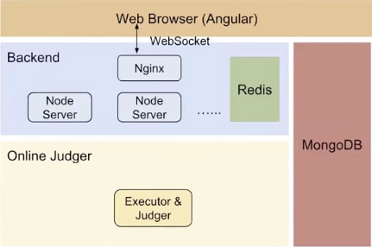
IP02: Requirement and Architecture
Differences :
(2) Software Architecture
The Collaborative Online Judge System
Service Oriented Architecture (SOA) : multiple sub-services in this application, such as the Agular-based frontend, Node.js-based backend, WebSocket-based communication channel between frontend and backend, Caching layer, Background processes such as the judges, databases.
Notes:
our Four projects have different high-level architectures.
The Collaborative Online Judge uses a Service Oriented Architecture (SOA) where are multiple sub-services in this application, such as the Agular-based frontend, Node.js-based WebSocket-based communication channel between frontend and backend, Caching layer,
Background processes All these sub-services will communicate in different ways.

Slide 13
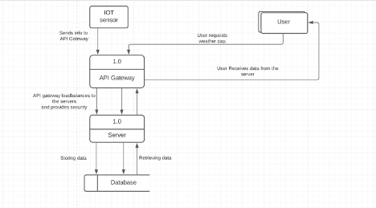
IP02: Requirement and Architecture
Differences :
(2)Software Architecture
IoT-based weather application System:
The Three-tier architecture: There is a presentation tier (the user interface), an application server tier (the API Gateway and the server), a data tier (the database) and another tier called the IOT sensor.
Notes:
The IoT-based weather app uses the Three-tier architecture. which included presentation tier (the user interface), an application server tier (the API Gateway and the server), a data tier (the database). There is another tier called the IoT sensor, however, it is still the traditional three-tier architecture. This architecture is well-established and easy to implement

Slide 14
IP02: Requirement and Architecture
Differences :
(2) Software Architecture
Password Management System:
A microservice-based architecture: It has multiple components which will communicate with each other through well-defined protocols such as HTTP or RPC
The vaccine scheduler system:
MVC architecture: allows the creation of a dynamic website where the user can see dynamically generated pages and can submit data. The model part will be necessary to have persistent data. Separating Model, View, and Controller makes the web apps more maintainable. Each of these components is built to handle specific development aspects of an application.
Notes:
Password Management is somewhat between the two styles. it is more like a microservice-based architecture, since it has multiple components which will communicate with each other through well-defined protocols such as HTTP or RPC.
The vaccine scheduler system uses MVC architecture which is an architectural pattern that separates an application into three main logical components: the model, the view, and the controller. In this system, MVC allows the creation of a dynamic website where the user can see dynamically generated pages and can submit data.

Slide 15
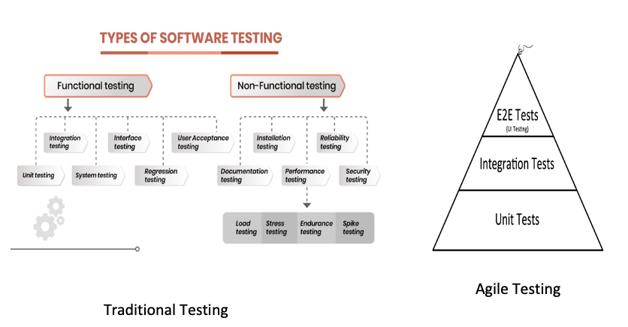
IP03: Test Plan And Cases
Test Practices

Slide 16
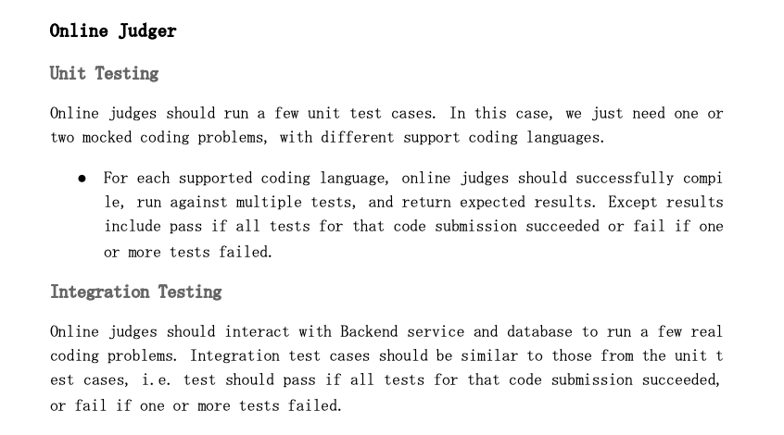
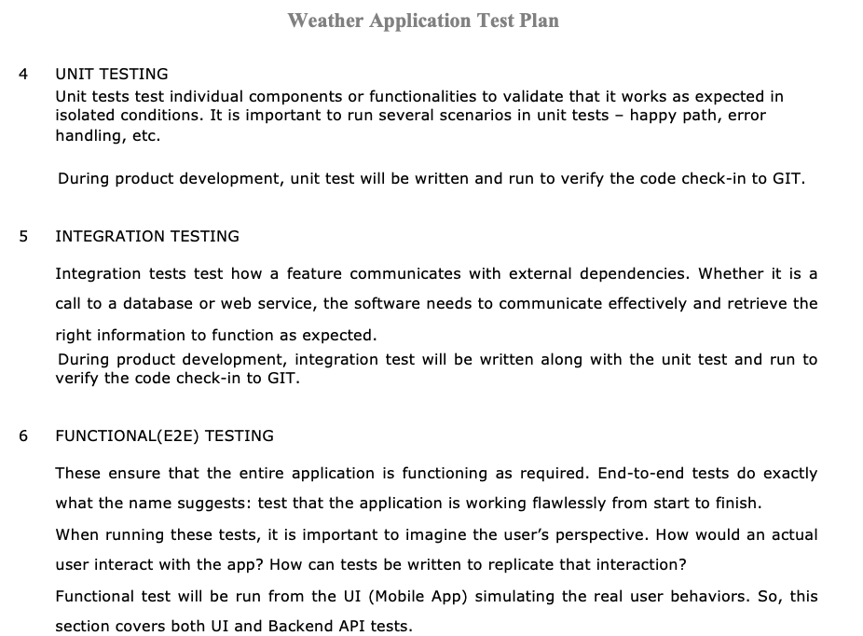
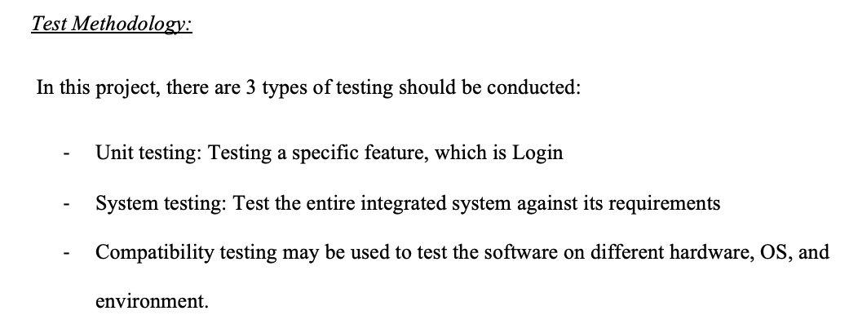
IP03: Test Plan And Cases
Similarities
Test plan consistent with the process model
Well defined test coverage, test goals, test scope and test entry/exit criteria
Test cases based on the test plan
Well defined test metrics

Slide 17
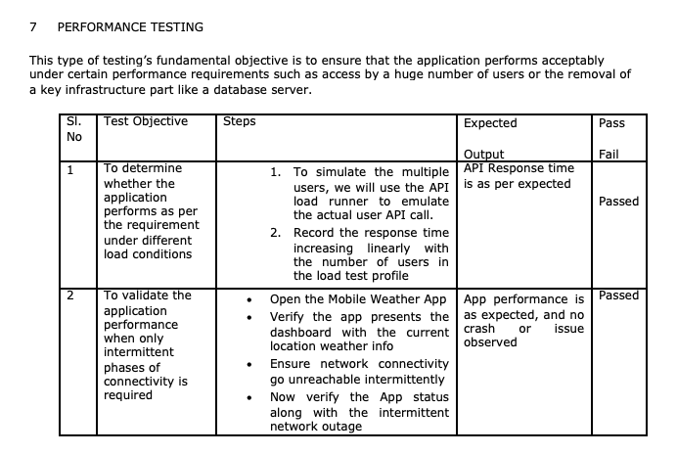
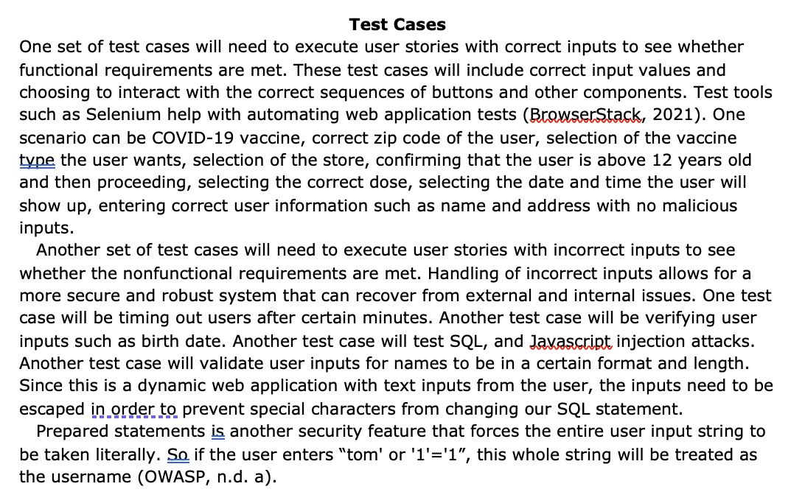
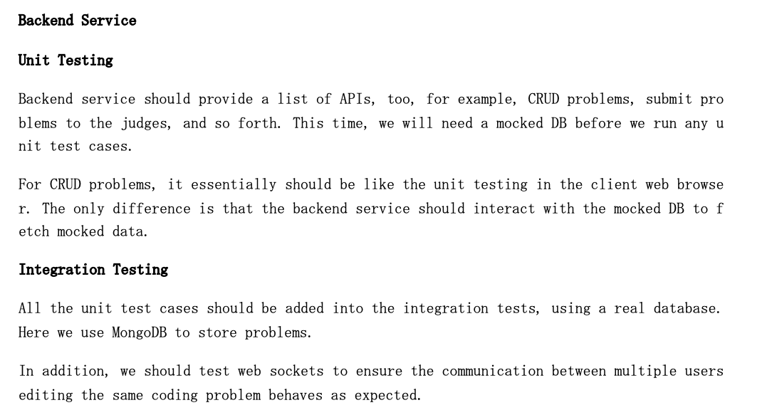
IP03: Test Plan And Cases
Different models of testing – Agile and Traditional
Different types of testing covered
Different types of test case formats

Slide 18

IP04: Software Metrics
What are software metrics?
Why are software metrics important?
Benefits of software metrics:
-Increase return on investment (ROI)
-Identify areas of improvement
-Manage workloads
-Reduce overtime
-Reduce costs
Notes:
What are software metrics? A software metric is a measure of software characteristics that are quantifiable or countable.
Why are software metrics important? In order to understand why these metrics are necessary, one needs to understand the purpose of software testing.
The purpose of software testing is to ensure that the software product is above a predetermined quantifiable level of quality. This is because the software team agrees to spend a certain amount of resources on testing to ensure the number of tests, coverage, rate of bugs and failed tests. Metrics allows the development team to determine whether the software product is above the predetermined level of quality which makes it ready for deployment. This is why metrics are necessary for acceptance testing of a software product.

Slide 19
IP04: Software Metrics
IoT-based weather application’s metrics were focused on the code. The rate of tests that discover bugs, coverage, rate of failed tests. The goal is 95% code coverage and 95% test pass rate with the 5% not including any critical functionality.
Password manager project analyzed metrics for usability, security, and validation testing. What matters to the user is the user experience and functionalities.
Collaborative online judge system metrics were divided into functional (user stories) and non functional (security, availability, and performance).
Vaccine scheduler has metrics for functional coverage, non functional (security, safety, performance, and usability), code coverage, and failed test rate.

Slide 20
IP04: Software Metrics
Similarities
Metrics for usability
Metrics for security
Metrics for defects
Differences
Author #2 was the only one who had metrics for software maintainability.
Metrics differed due to different requirements. IoT-based Weather app is concerned with effectiveness, coverage, and defect distribution. The password system, however, is concerned with usability, security, and maintainability.

Slide 21
Conclusion
GitHub is a great platform for managing configuration data.
A software requirements specification is the basis for the entire project. It lays the framework that every team involved in development or in our case, each student needed to follow.
Writing an SRS can also minimize overall development time and costs.
The test plan keeps track of possible tests that will be run on the system after coding
Software metrics are objectives, quantitative assessments, and standard measurements of software attributes..
Notes:
After completing these 4 independent projects over the last 8 weeks, the authors understood that having a process and documentation is very important at every stage to ensure that they can monitor and guide the software project towards a successful end.
GitHub is a great platform for managing configuration data. Moving configuration data into a GitHub repository enables better version controlling and the repository to act as a source of truth. Version control also solves another configuration problem: unexpected breaking changes. Managing unexpected changes using code review and version control helps to minimize downtime.
A software requirements specification is the basis for the entire project. It lays the framework that every team involved in development or in our case, each student needed to follow. It should be written to provide critical information to multiple teams — development, quality assurance, operations, and maintenance. This keeps everyone on the same page. Using the SRS helps to ensure requirements are fulfilled. And it can also help you make decisions about our product’s lifecycle — for instance when to retire a feature. Writing an SRS can also minimize overall development time and costs. Embedded development teams especially benefit from using an SRS.
Design documents guide us regarding the design pattern to flow and flowcharts such as DFD, UML, and ER diagrams help us understand the flow of data.
The test plan keeps track of possible tests that will be run on the system after coding. The most important test cases come from the requirements of the system. When the system is in the design stage, the initial tests can be refined a little. During the detailed design or coding phase, exact test cases start to materialize. After coding, the test points are all identified, and the entire test plan is exercised on the software.

Slide 22
References
Ross, D. T., Goodenough, J. B., and Irvine, C. A. "Software Engineering: Process, Principles, and Goals," in Computer, vol. 8, no. 5, pp. 17-27, May 1975, doi: 10.1109/C-M.1975.218952.
Davis, A. M. "Fifteen principles of software engineering," in IEEE Software, vol. 11, no. 6, pp. 94-96, Nov. 1994, doi: 10.1109/52.329409.
Ebert, C., Murthy, B. K., and Jha, N. N. "Managing Risks in Global Software Engineering: Principles and Practices," 2008 IEEE International Conference on Global Software Engineering, 2008, pp. 131-140, doi: 10.1109/ICGSE.2008.12.
Mohod A.(2015). Why test cases are so important https://blog.e-zest.com/why-test-cases-are-so-important/
ReQtest. (2016). The Pros & Cons of Using a Test Plan. https://reqtest.com/testing-blog/using-test-plan/
Buchanan, I. (n.d). Configuration Management. https://www.atlassian.com/continuous-delivery/principles/configuration-management
Kruger N (2018). How to write software requirement specification documentation. https://www.perforce.com/blog/alm/how-write-software-requirements-specification-srs-document
Cigniti Technologies (n.d). Why do you need software testing metrics? https://www.cigniti.com/blog/why-do-you-need-software-testing-metrics/

Slide 23


Q&A

